Slide 1

Disputed Territories on Map Stamps
Ed Zuckerman

Slide 2
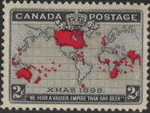
Who owns the world? Canada #85 (1898)

Slide 3
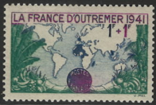
France (1941)

Slide 4
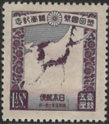
Japan #208 (1930)

Slide 5
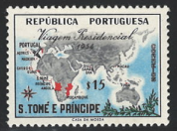
St. Thomas & Prince Islands (Portugal)

Slide 6
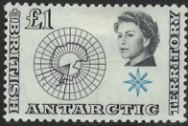
Who owns Antarctica? Great Britain

Slide 7
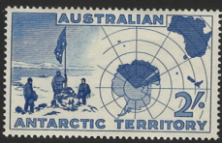
Australia

Slide 8
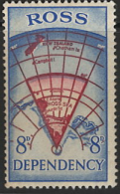
New Zealand

Slide 9
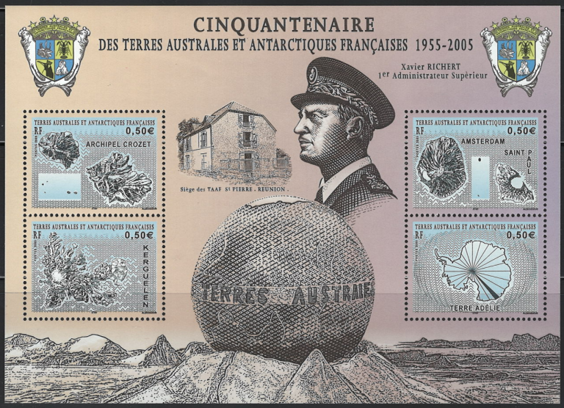
France

Slide 10
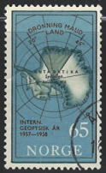
Norway

Slide 11
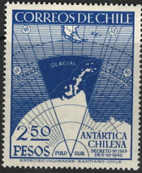
Chile

Slide 12
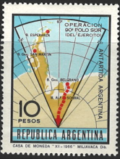
Argentina

Slide 13
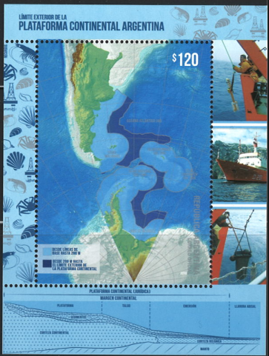

Slide 14
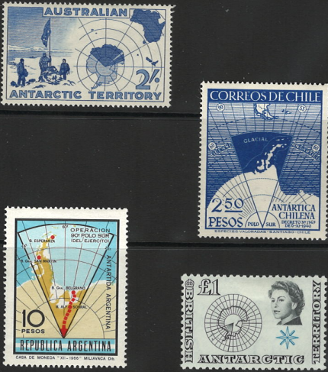

Slide 15
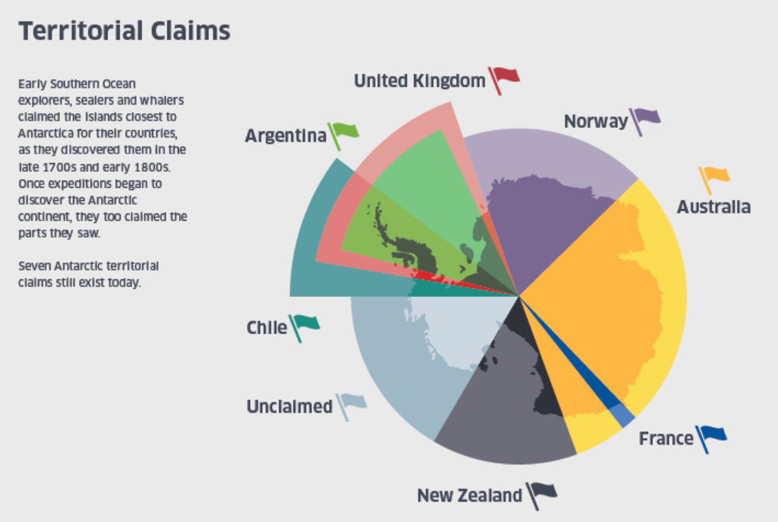
x

Slide 16
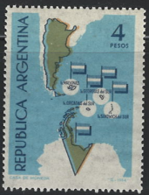

Slide 17
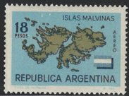
Islas Malvinas?

Slide 18
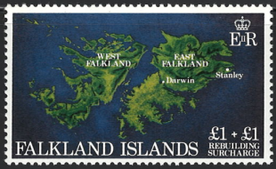
Falkland Islands

Slide 19


Slide 20
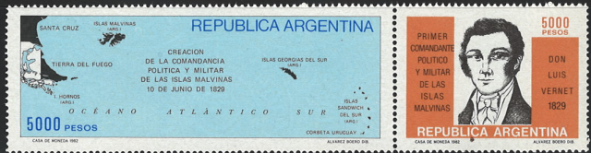
Islas Malvinas

Slide 21

Israel/Palestine
1948

Slide 22
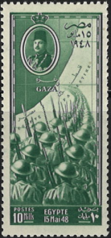
1948

Slide 23
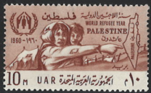
1960

Slide 24
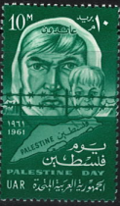
1961

Slide 25
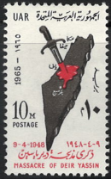
1965

Slide 26
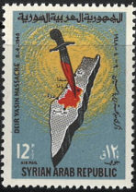
1965

Slide 27
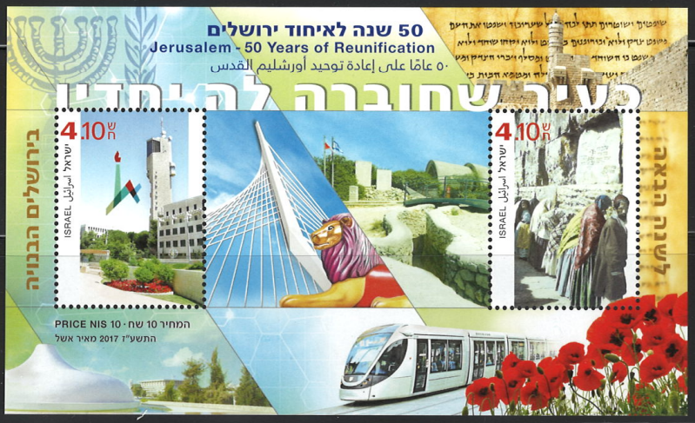

Slide 28

Re: Gaza

Slide 29
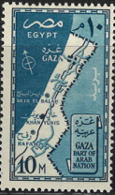
1957

Slide 30
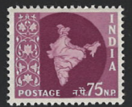
Kashmir
(1957)

Slide 31
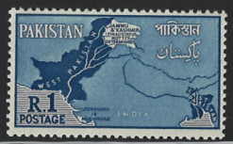
(1960)

Slide 32
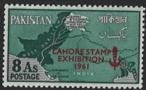

Slide 33
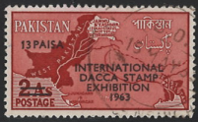

Slide 34
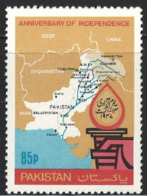

Slide 35
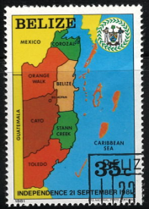
Belize/
Guatemala

Slide 36
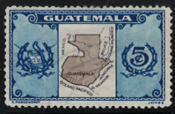
Guatemala #279 (1936)

Slide 37
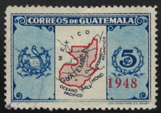
Guatemala #296 (1939)

Slide 38
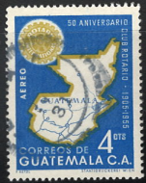
(1956)

Slide 39
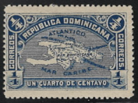
Hispaniola
Dominican Republic #111 (1900)

Slide 40
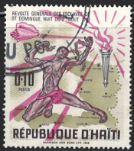
Hispaniola

Slide 41
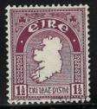
Missing line?
Ireland #22 (1922)

Slide 42
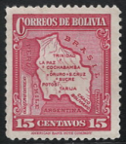
The Chaco War
Bolivia #224 (1935)

Slide 43
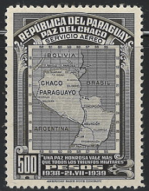
Paraguay C121 (1939)

Slide 44
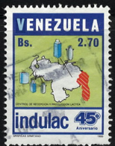
Venezuela/
Guyana

Slide 45
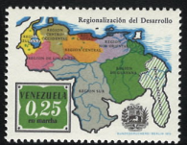

Slide 46
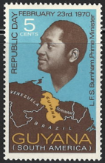

Slide 47
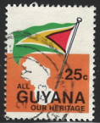

Slide 48
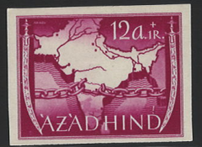
Azad Hind
Prepared but not issued (1941)

Slide 49
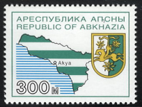
Abkhazia

Slide 50
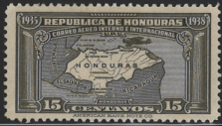
Honduras/Nicaragua Honduras C79 (1935)

Slide 51
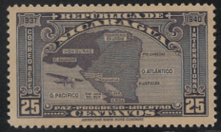
Nicaragua C189 (1937)

Slide 52
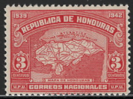

Slide 53
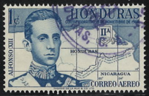
1961

Slide 54
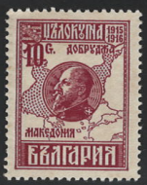
Oops Bulgaria, Scott #153 (printed 1915, issued 1921)

Slide 55
TBA , Scott #

Slide 56

TBA , Scott #

Slide 57

TBA , Scott #

Slide 58


Slide 59
TBA , Scott #

Slide 60
TBA , Scott #

